Slide 1


Missing Data Treatment
A hand-on illustration using package mice

Slide 2
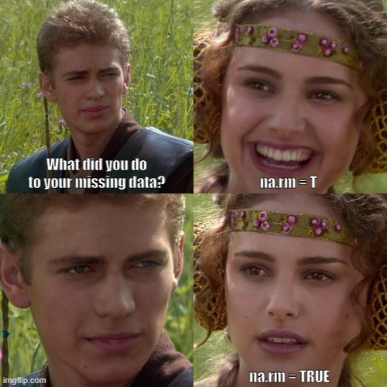
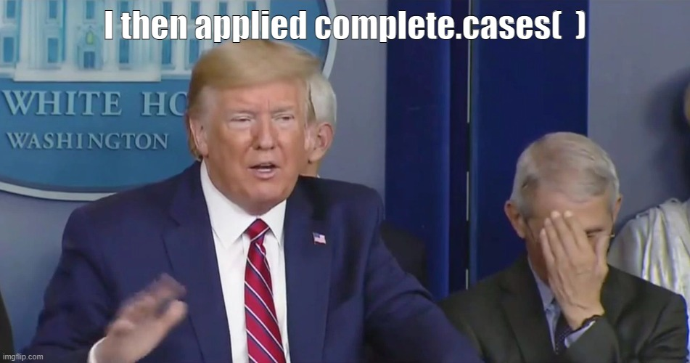
Complete-case Analyses

